Slide 1



IIIT DHARWAD
Analysis of
AIRLINE TRAVEL REACHABILITY NETWORK
ARPIT NAYAK 22BDS006
VIRAJ SURANA
RAJPUT AJAY 22BDS049
22BDS064
BHABAD GANESH 22BDS067
Page | 01.

Slide 2



MOTIVATION
OBJECTIVES
Airline networks drive regional connectivity and economic growth.
Analyzing their structure helps optimize routes, identify key hubs, and enhance resilience, ensuring efficient and robust transportation systems
By understanding these dynamics, we can strengthen the network's capacity to support social mobility and economic development effectively.
To analyze and extract key properties and insights from the North American Airline Reachability Network.
To query the network and identify critical hubs, routes, and regional connections.
To compute centrality measures, visualize connectivity, and assess network robustness.
To draw meaningful real- world inferences on network efficiency, resilience, and structure.
Page | 02.

Slide 3


IIIT DHARWAD
DATA
TREATMENT
Each city is treated as a node in the network
Dataset Overview: This dataset represents a transportation reachability network connecting cities across the United States and Canada. The network is directed and asymmetric, with edges weighted by estimated airline travel time, including potential stopover delays.
City Metadata: For each city node, metadata includes the metropolitan population, latitude, and longitude.
Data Sources: The network data is sourced from Brendan J. Frey and Delbert Dueck (2007), and city metadata from Austin R. Benson, David F. Gleich, and Jure Leskovec (2016), providing credible references for both reachability structure and city- specific information.
Page | 03.
An edge from city i to city j exists if there is a direct airline connection and if the travel time meets a specified threshold.
Due to headwinds and other factors, this network is asymmetric, meaning travel times may differ depending on direction.
The inclusion of city populations and geographic coordinates enriches the analysis with demographic and spatial insights.

Slide 4



METHODOLOGY
IIIT DHARWAD
Objective: Collect relevant data and construct a network model.
Data Gathering: Extract network data from the provided sources, focusing on key entities (nodes) and relationships (edges).
Preprocessing: Clean and format the data to ensure consistency, removing duplicates and handling missing values.
Network Creation: Use NetworkX to define nodes and edges, creating a foundational structure for the network. Attributes like edge weights or node types are added for richer analysis.
Data Collection and Network Construction
Objective: Identify influential nodes using centrality measures.
Degree Centrality: Measures the number of direct connections a node has, helping to identify highly connected nodes.
Eigenvector Centrality: Determines a node’s influence based on connections to other influential nodes, highlighting critical nodes in the network.
Analysis is performed to compute features like - degree centrality, betweenness centrality, closeness centrality, eigenvalue centrality, degree distributions, weighted degree distributions, degree correlations, cumulative strength distributions, clustering coefficient, path length distributions, small world properties, etc.
Application: Use these metrics to identify nodes that act as major influencers or hubs within the network, guiding targeted analysis or interventions.
Extraction Properties
Page | 04

Slide 5

IIIT DHARWAD
Objective: Visualize the network structure and key insights.
NetworkX: Generate static layouts to reveal network structure and initial patterns.
Dash: Build interactive dashboards, allowing users to explore centrality measures, filter nodes, and interact with the network graph.
Folium: Create map-based visualizations to add geographic context, displaying nodes and edges spatially for enhanced insight.
Community Detection: Use visualization tools to highlight network communities or clusters, revealing groups of closely connected nodes for further investigation.
Network Visualization
Methodology Slide 4: Analysis and Interpretation Objective: Analyze the network and interpret findings.
Visual Analysis: Observe patterns, clusters, and high-centrality nodes in visualizations, interpreting the network’s structure.
Metric Comparison: Compare results from degree and eigenvector centrality to validate influential nodes.
Insight Generation: Draw conclusions on network dynamics, identifying key actors, potential vulnerabilities, or critical pathways that inform further decisions.
Impact Assessment: Assess the potential impact of key nodes or clusters on overall network behavior, providing actionable insights for real-world applications.
Analysis and Interpretation
Page | 04.

Slide 6


INFERENCE & RESULTS
IIIT DHARWAD
Most "popular" nodes:
Degree Centrality
Nodes (cities): 456
Type of Graph: Directed Edges: 71959
Los Angeles, CA | 1.9472
San Francisco, CA | 1.9142
Las Vegas, NV | 1.8923
Chicago, IL | 1.8879
Dallas/Fort Worth, TX | 1.8879
Average path length: 1.6357 Maximum path length: 3 round trips Diameter: 3 round trips
Clustering Coefficient : 0.8052
Average In-Degree: 157.80
Average Out-Degree: 157.80 Weighted Average Degree: -54931.40 Connected components: 1
Bridge nodes: | Betweenness Centrality
Los Angeles, CA | 0.017566
Denver, CO | 0.016632
New York, NY | 0.015964
Toronto, ON | 0.015952
San Francisco, CA | 0.015807
Longest airplane route: 2855 min Shortest airplane route: 10 min
Most Influential nodes:
Closeness Centrality
Los Angeles, CA | 0.97430
San Francisco, CA | 0.97014
Dallas/Fort Worth, TX | 0.95188
Chicago, IL | 0.94594
Las Vegas, NV | 0.94594
Maximum time delay between any two consecutive city: 2835 min
Minimum time delay between any two consecutive city: 1 min Average total airplane route time: 54931.4 min
Average time delay between consecutive stops: 0.76 min
Page | 05.

Slide 7


The average clustering coefficient of 0.8052 indicates a substantial level of clustering across the network. This value suggests that cities in the network are not only connected to key hubs but also exhibit connections to each other within local clusters or regional groups.
A negative assortativity coefficient implies that high-degree nodes (hubs) tend to connect with low-degree nodes rather than other high-degree nodes.Efficient Connectivity: Negative assortativity supports efficient reachability from smaller
Maximum path length of the network is 3, i.e. there are 3 Flight changes required to reach from a specific station to another.
There is only One component meaning that starting from any City ,you can reach any other City
Airline Reachability Network is completely connected, it has only One connected component. That is, it is possible to reach any stations starting from any other specific stations in the Network
An average path length of 1.67 indicates that most nodes in the network can be reached from any other node in just one or two steps. This is relatively short and suggests that the network is quite dense and well connected.
Page | 06

Slide 8
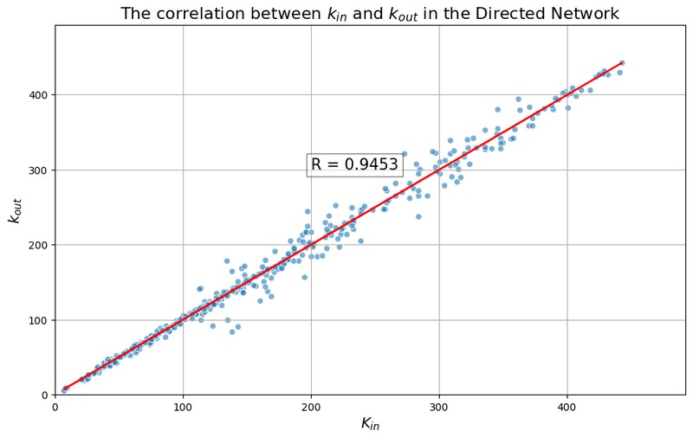

The Correlation between K_{in} and
^{K}out
A reciprocity of 0.9453 in airline reachability network indicates a very high likelihood of mutual connections between city pairs.
In other words, if there is a direct flight from City A to City B, there’s a strong probability of a reciprocal flight from City B back to City A
This highlights a well-balanced, two-way connectivity network that serves both operational efficiency and passenger convenience.
This structure makes the network resilient and economically viable, supporting seamless travel across cities in both directions.
Click Here
Linearity of Relationship:
The points are closely aligned with the red line (representing perfect correlation), indicating that as the in-degree increases, the out-degree increases proportionally.
This suggests that for most cities, the distribution of incoming and outgoing connections is balanced, and cities are not only receiving flights but are also equally connected in the opposite direction
Page | 07.

Slide 9

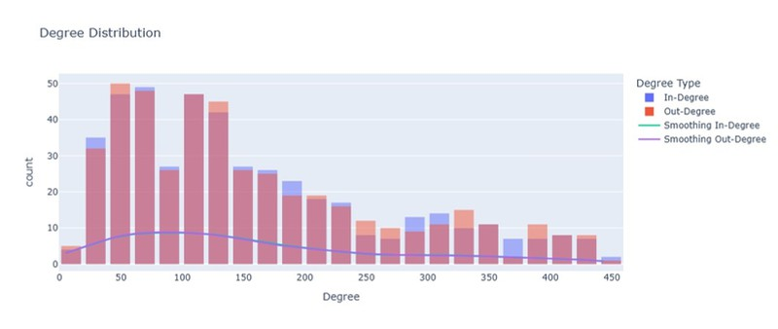
DEGREE DISTRIBUTION OF
In-Degree and Out-Degree
The distribution shows that most nodes in the network have a relatively low degree (in both in-degrees and out- degrees), which is common in networks with a few high- degree nodes and many
low-degree ones
The count decreases as the degree increases, indicating a skewed distribution where only a few nodes have high in-degrees or out-degrees.
The bars show the counts of nodes with various degrees. The red bars represent out-degrees, and the blue bars represent in-degrees.
Generally, out-degrees seem more prevalent than in-degrees across most degree values, suggesting that nodes tend to have more outgoing connections than incoming ones in this network.
Page | 08.
Click Here

Slide 10

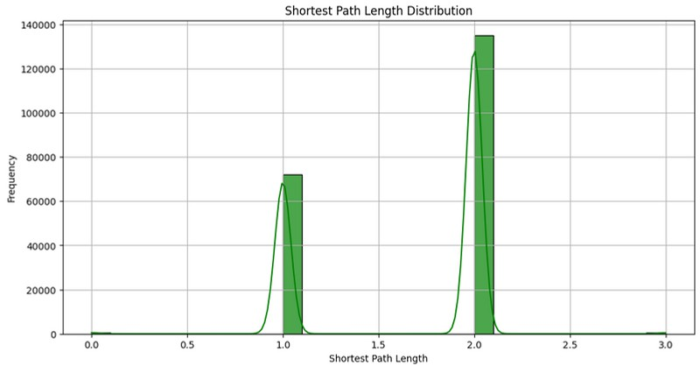
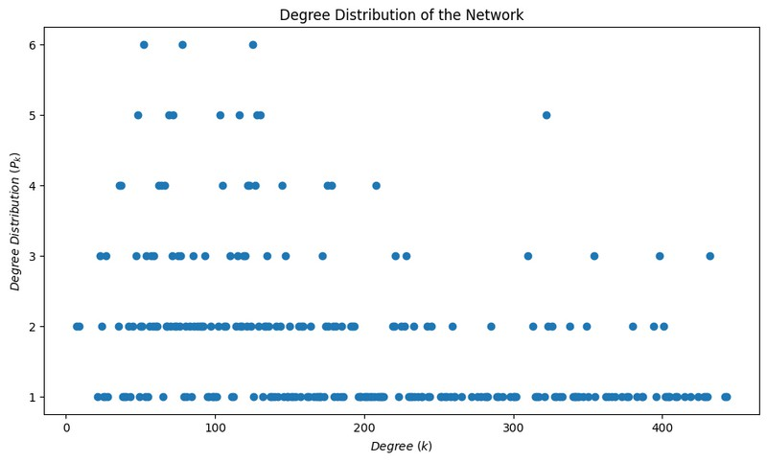
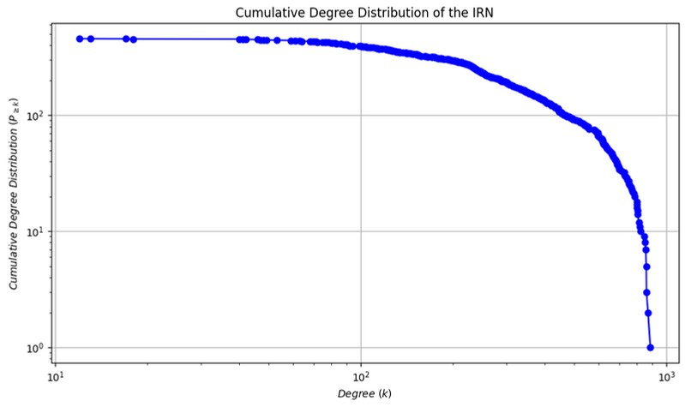
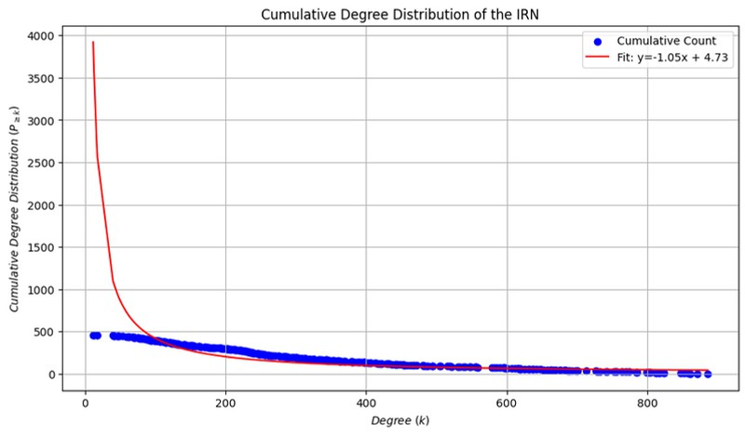
06.

Slide 11

IIIT DHARWAD
THANKS
Git-Hub Link for the Project:
Click Here
Page | 09.

